Slide 1
An Introduction to Neural Network Language Model
Wang Qiang
2015.12.06

Slide 2
Overview
Statistical N-Gram LM
FNN-LM (Feedforward Neural Network)
Motivation
What’s FNN
What’s FNN-LM
How to train FNN
*RNN-LM (Recurrent Neural Network)
What’s RNN
Vanishing gradient problem
*LSTM-LM (Long Short-Term Memory)
What’s LSTM
Conclusion
* means sketch

Slide 3
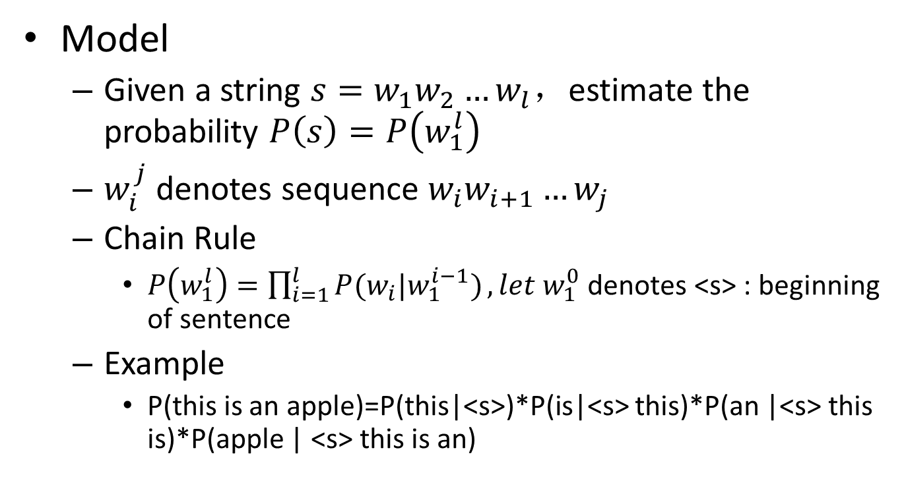
Language Model
Model
Given a string $s=w_{1}w_{2}…w_{l}$，estimate the probability $P\left(s\right)=P\left(w_{1}^{l}\right)$
$w_{i}^{j}$ denotes sequence $w_{i}w_{i+1}…w_{j}$
Chain Rule
$P\left(w_{1}^{l}\right)=\prod_{i=1}^{l}{P(w_{i}|w_{1}^{i−1})},let{ w}_{1}^{0}$ denotes <s> : beginning of sentence
Example
P(this is an apple)=P(this|<s>)*P(is|<s> this)*P(an |<s> this is)*P(apple | <s> this is an)

Slide 4
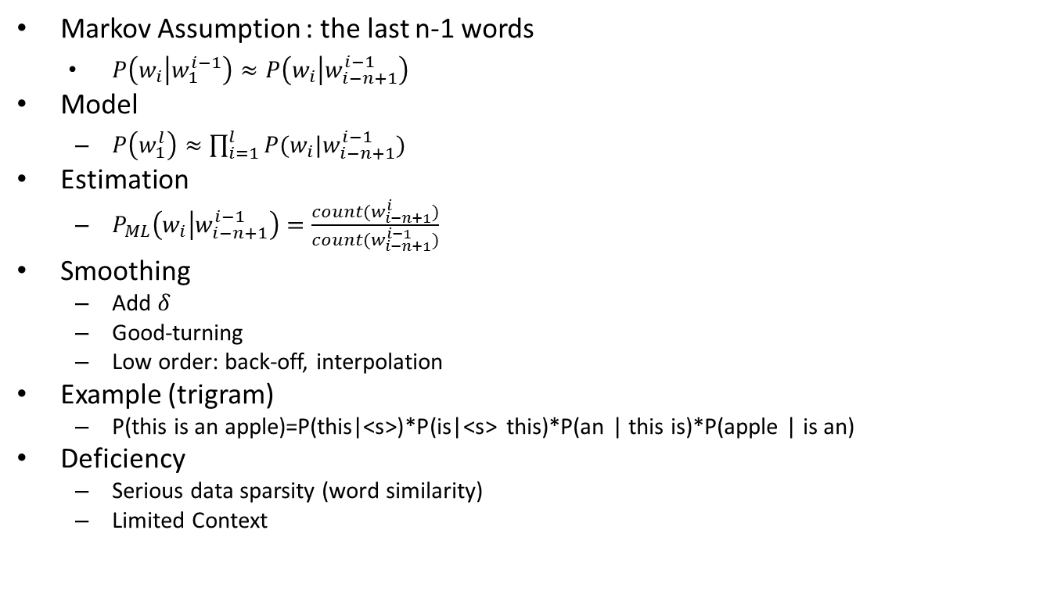
N-Gram Language Model
Markov Assumption : the last n-1 words
$P\left(w_{i} | w_{1}^{i−1}\right)≈P\left(w_{i} | w_{i−n+1}^{i−1}\right)$
Model
$P\left(w_{1}^{l}\right)≈\prod_{i=1}^{l}{P(w_{i}|w_{i−n+1}^{i−1})}$
Estimation
$P_{ML}\left(w_{i} | w_{i−n+1}^{i−1}\right)=\frac{count(w_{i−n+1}^{i})}{count(w_{i−n+1}^{i−1})}$
Smoothing
Add $δ$
Good-turning
Low order: back-off, interpolation
Example (trigram)
P(this is an apple)=P(this|<s>)*P(is|<s> this)*P(an | this is)*P(apple | is an)
Deficiency
Serious data sparsity (word similarity)
Limited Context
FNN-LM
RNN-LM & LSTM-LM

Slide 5
FNN-LM
Reference
A Neural Probabilistic Language Model(Bengio et al, NIPS’2000 and JMLR 2003)
Motivation
Not taking account of contexts farther than 2 words (also, n can be larger, but due to data scarcity, for all unseen ngram, smoothing causes to use only short context)
Not taking account of similarity between words
Core thought
Distributed representation for words

Slide 6
FNN-LM
Why do we need distributed representation?
In statistical LM, word is discrete, such as “hello”=1, “world”=2, no relations between any words
Due to discrete, a small change maybe causes a drastic impact on estimated value
Discrete: “this dog”=(1,2), “that cat”=(3,4),totally different
Continuous: “this dog”=([1,1],[2,2]),”that cat”=([0.9,1.1],[2.1,1.9]),we can see these are similar
Effect: train with same data, distributed representation help to get more information and have more powerful generalization

Slide 7
FNN-LM
What’s FNN
the information moves in only one direction, forward, from the input nodes, through the hidden nodes (if any) and to the output nodes
Instance: single-layer perceptron; logistic regression; multi-layer perceptron
Here the FNN-LM is just a MLP

Slide 8
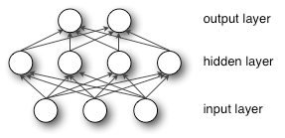
FNN-LM
MLP(single-hidden-layer)
MLP can be seen:
Input->Hidden(Hidden->Hidden) : perceptron with a special activation function (sigmoid, tanh); actually when using sigmoid, it’s like logistic regression
Hidden->Output: softmax function(Multiclass, Probability output)

Slide 9
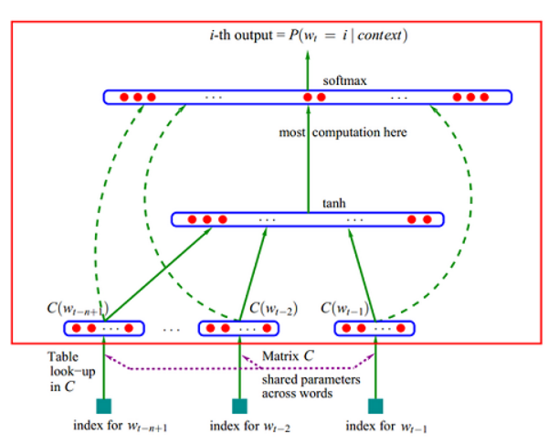
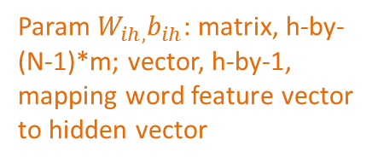
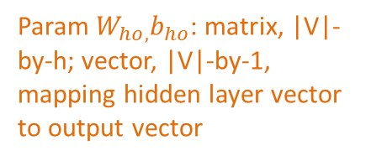
FNN-LM
Dashed line means input layer connect with output layer directly, optionally. In this slides, we don’t do this !
Output layer: vector, |V|-by-1, use softmax, each element denotes indexed word probability given current context
Param $W_{ho,}b_{ho}$: matrix, |V|-by-h; vector, |V|-by-1, mapping hidden layer vector to output vector
Tanh Hidden layer: h-by-1 vector
Param $W_{ih,}b_{ih}$: matrix, h-by-(N-1)*m; vector, h-by-1, mapping word feature vector to hidden vector
Word feature : m-by-1 vector, distributed representation for word
C is shared across different words.
Concatenate N-1 word feature vector as a whole vector , (N-1)*m-by-1
Param C: matrix, m-by-|V|, mapping a one-hot vector
(word) to a m-dimen vector
Input: a word, one-hot vector, |V|-by-1
Total N-1 words as context

Slide 10
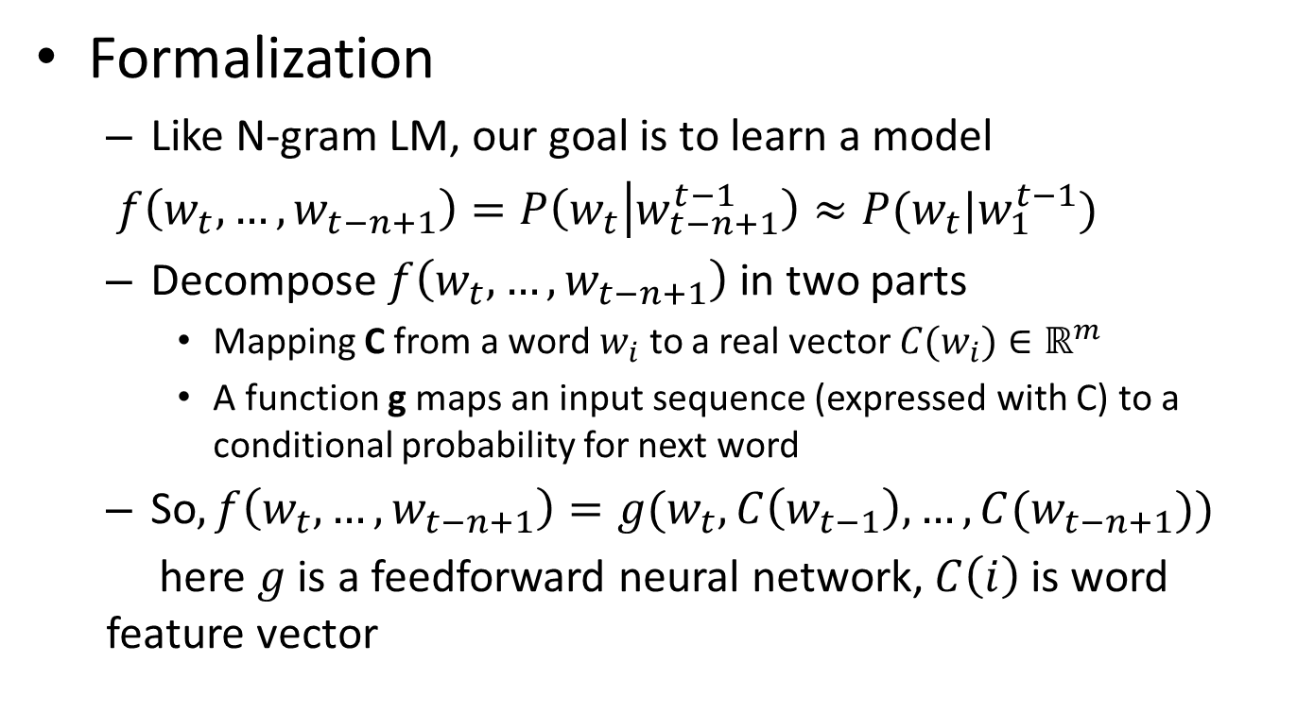
FNN-LM
Formalization
Like N-gram LM, our goal is to learn a model
$f\left(w_{t},…,w_{t−n+1}\right)=P\left(w_{t} | w_{t−n+1}^{t−1}\right)≈P(w_{t}|w_{1}^{t−1})$
Decompose $f\left(w_{t},…,w_{t−n+1}\right)$ in two parts
Mapping C from a word $w_{i}$ to a real vector $C(w_{i})∈ℝ^{m}$
A function g maps an input sequence (expressed with C) to a conditional probability for next word
So$,f\left(w_{t},…,w_{t−n+1}\right)=g(w_{t},C\left(w_{t−1}\right),…,C(w_{t−n+1}))$
here $g$ is a feedforward neural network, $C\left(i\right)$ is word feature vector

Slide 11

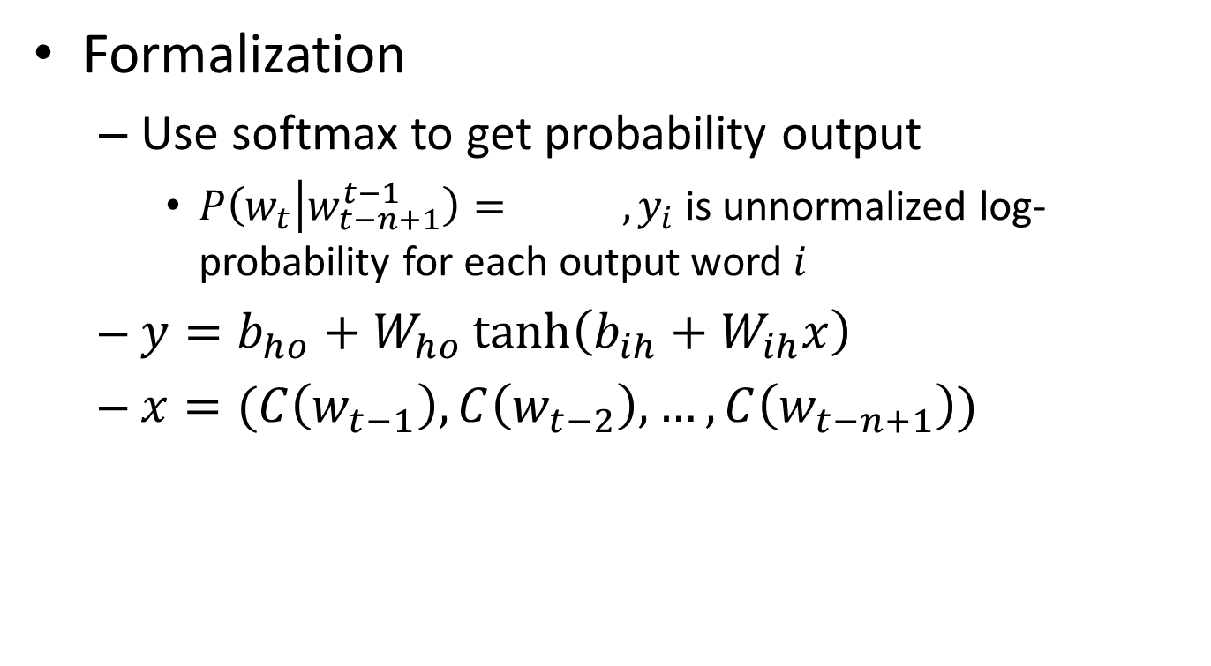
FNN-LM
Formalization
Use softmax to get probability output
$P\left(w_{t} | w_{t−n+1}^{t−1}\right)= ,y_{i}$ is unnormalized log-probability for each output word $i$
$y=b_{ho}+W_{ho}\tanh\left(b_{ih}+W_{ih}x\right)$
$x=(C\left(w_{t−1}\right),C\left(w_{t−2}\right),…,C\left(w_{t−n+1}\right))$
Hidden layer output

Slide 12
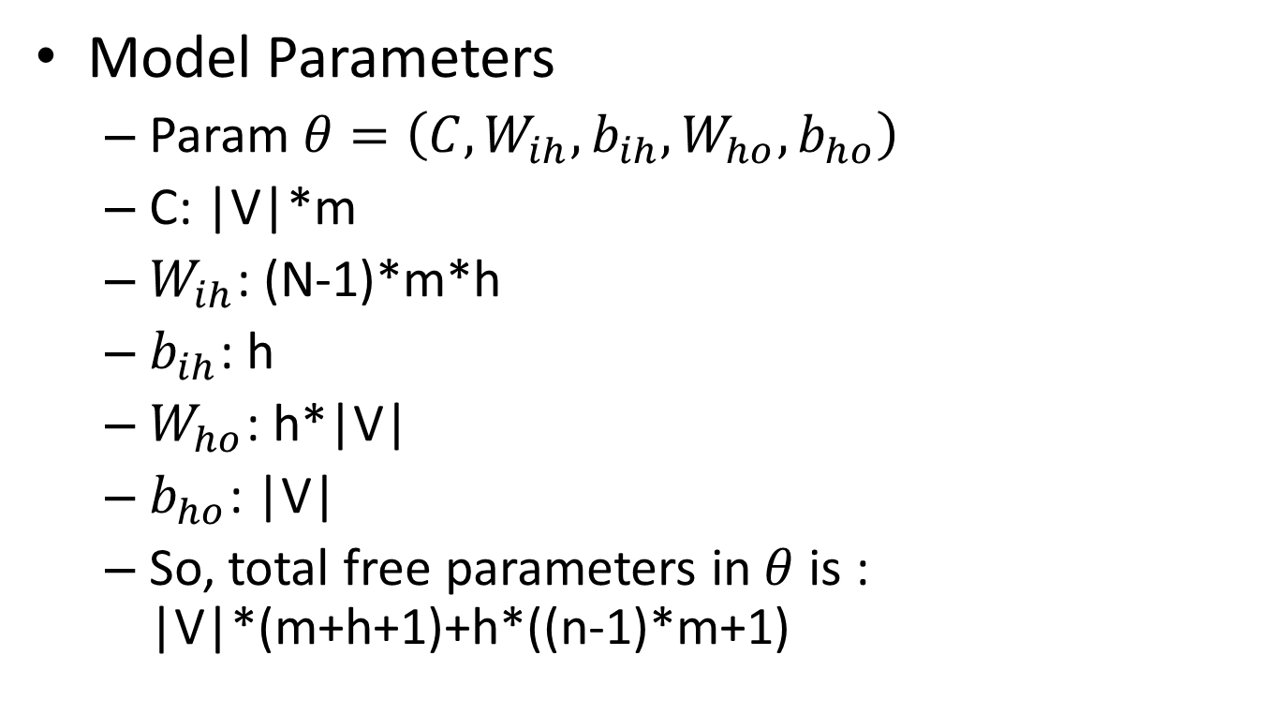
FNN-LM
Model Parameters
Param $θ=\left(C,W_{ih},{b_{ih},W}_{ho},b_{ho}\right)$
C: |V|*m
$W_{ih}$: (N-1)*m*h
$b_{ih}$: h
$W_{ho}$: h*|V|
$b_{ho}$: |V|
So, total free parameters in$θ$ is : |V|*(m+h+1)+h*((n-1)*m+1)

Slide 13
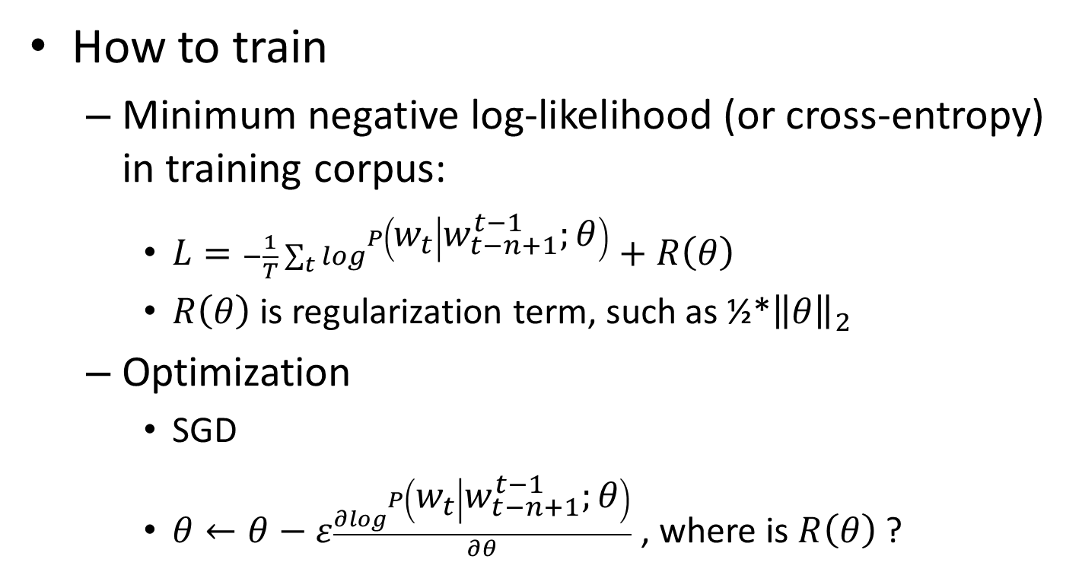
FNN-LM
How to train
Minimum negative log-likelihood (or cross-entropy) in training corpus:
$L=−\frac{1}{T}\sum_{t}{\log^{P\left(w_{t} | w_{t−n+1}^{t−1};θ\right)}}+R\left(θ\right)$
$R\left(θ\right)$ is regularization term, such as ½*${\left\|θ\right\|}_{2}$
Optimization
SGD
$θ←θ−ε\frac{∂\log^{P\left(w_{t} | w_{t−n+1}^{t−1};θ\right)}}{∂θ}$ , where is $R\left(θ\right)$ ?

Slide 14
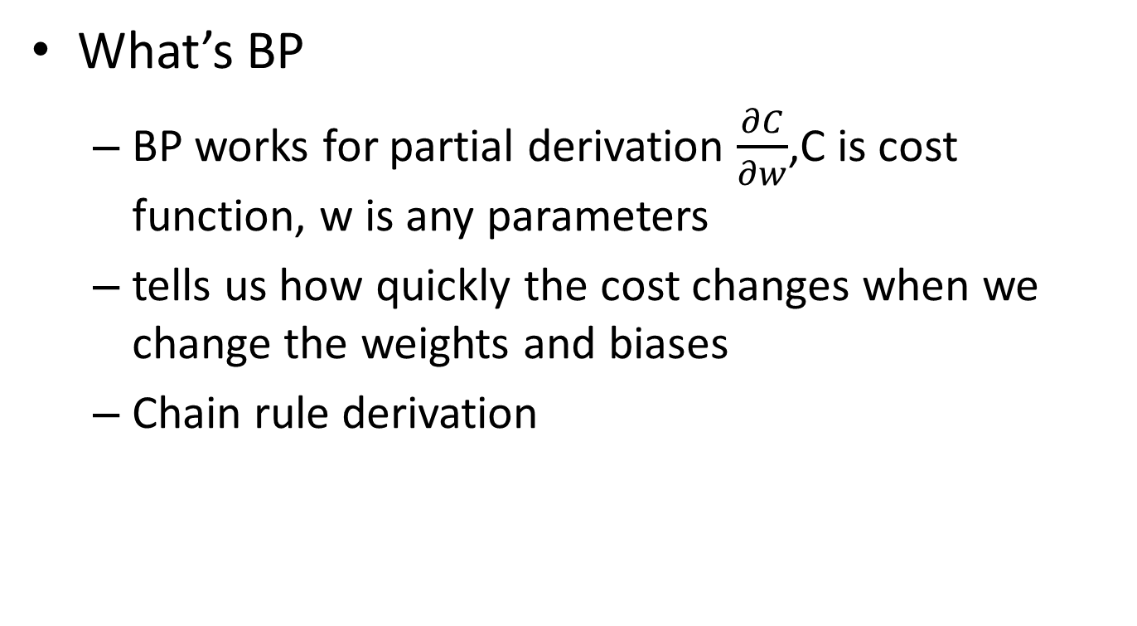
Back Propagation Algorithm
What’s BP
BP works for partial derivation $\frac{∂C}{∂w}$,C is cost function, w is any parameters
tells us how quickly the cost changes when we change the weights and biases
Chain rule derivation

Slide 15



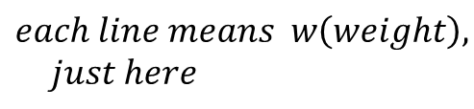

Back Propagation Algorithm
How to work (my understanding)
Image logistic regression (multi-class)
$$C(cost)$$
This is flow graph , not NN
$$σ(activation)$$
$$∑(linear sum )$$
$$each line means w\left(weight\right),$$
$$just here$$
$$X(input)$$

Slide 16


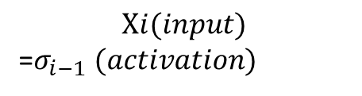
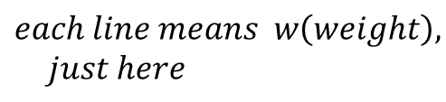
Back Propagation Algorithm
How to work (my understanding)
Image MLP
This is flow graph , not NN
$$C(cost)$$
………………………………………………………
$$Xi(input)$$
=$σ_{i−1} (activation)$
$$∑_{i−1}(linear sum )$$
$$X_{i−1}(input)$$
$$each line means w\left(weight\right),$$
$$just here$$

Slide 17

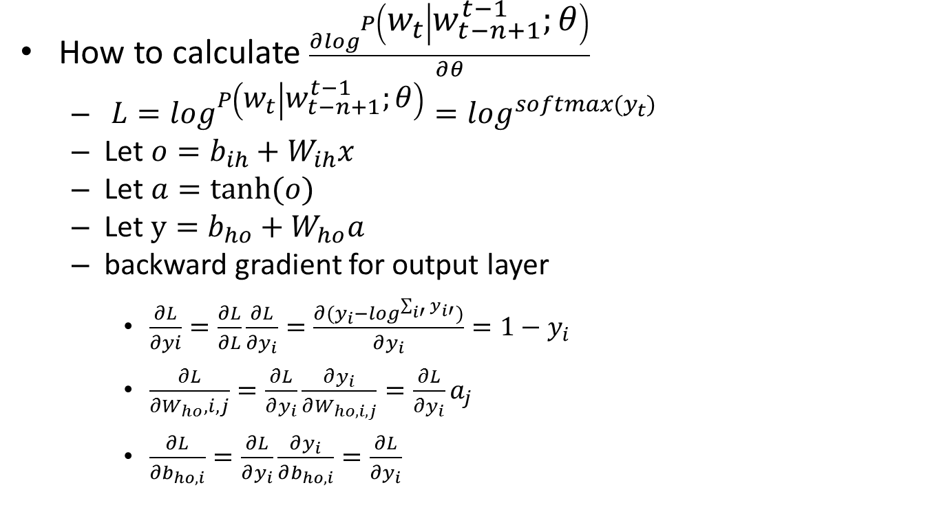
Back Propagation Algorithm
How to calculate $\frac{∂\log^{P\left(w_{t} | w_{t−n+1}^{t−1};θ\right)}}{∂θ}$
$L=\log^{P\left(w_{t} | w_{t−n+1}^{t−1};θ\right)}=\log^{softmax(y_{t})}$
Let $o=b_{ih}+W_{ih}x$
Let $a=tanh⁡(o)$
Let $y=b_{ho}+W_{ho}a$
backward gradient for output layer
$\frac{∂L}{∂yi}=\frac{∂L}{∂L}\frac{∂L}{∂y_{i}}=\frac{∂(y_{i}−\log^{\sum_{i′}{y_{i′}}})}{∂y_{i}}=1−y_{i}$
$\frac{∂L}{∂W_{ho},i,j}=\frac{∂L}{∂y_{i}}\frac{∂y_{i}}{∂W_{ho,i,j}}=\frac{∂L}{∂y_{i}}a_{j}$
$\frac{∂L}{∂b_{ho,i}}=\frac{∂L}{∂y_{i}}\frac{∂y_{i}}{∂b_{ho,i}}=\frac{∂L}{∂y_{i}}$
$x, o, a, y$ are all vector

Slide 18
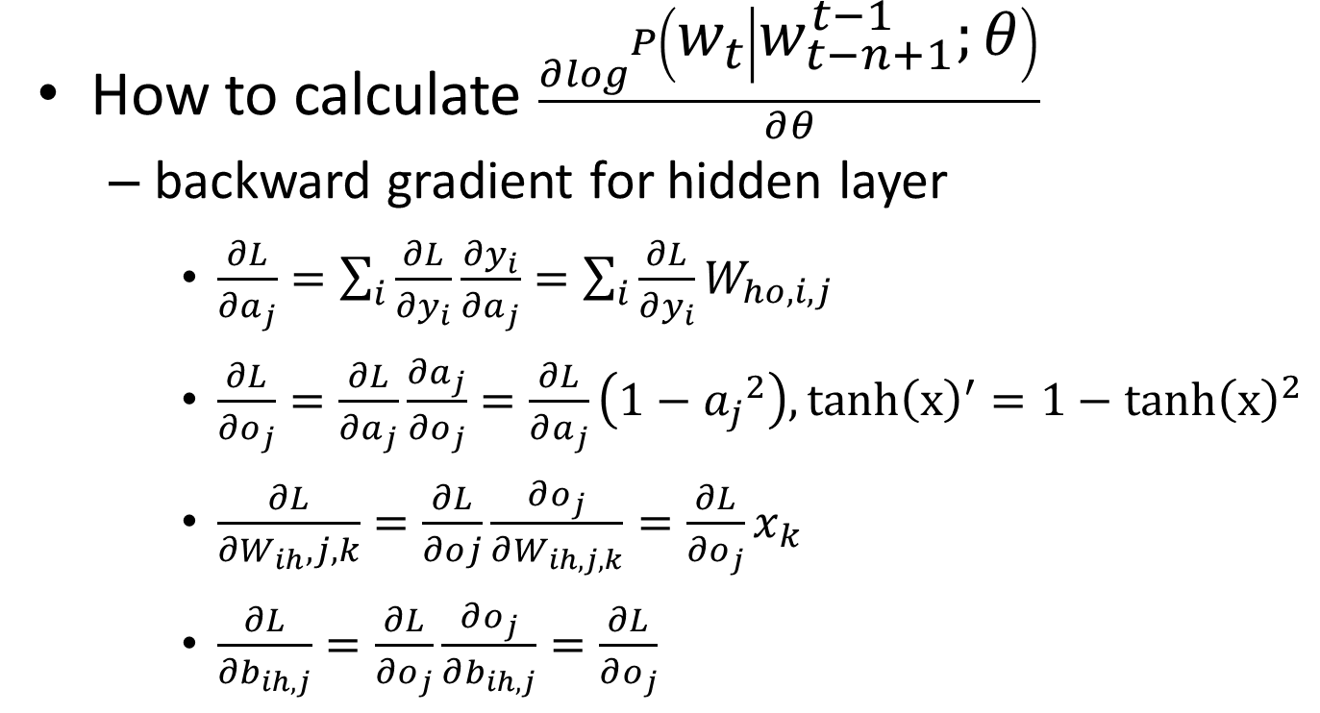
Back Propagation Algorithm
How to calculate $\frac{∂\log^{P\left(w_{t} | w_{t−n+1}^{t−1};θ\right)}}{∂θ}$
backward gradient for hidden layer
$\frac{∂L}{∂a_{j}}=\sum_{i}{\frac{∂L}{∂y_{i}}\frac{∂y_{i}}{∂a_{j}}}=\sum_{i}{\frac{∂L}{∂y_{i}}W_{ho,i,j}}$
$\frac{∂L}{∂o_{j}}=\frac{∂L}{∂a_{j}}\frac{∂a_{j}}{∂o_{j}}=\frac{∂L}{∂a_{j}}\left(1−{a_{j}}^{2}\right),tanh{\left(x\right)}^{′}=1−tanh{\left(x\right)}^{2}$
$\frac{∂L}{∂W_{ih},j,k}=\frac{∂L}{∂oj}\frac{∂o_{j}}{∂W_{ih,j,k}}=\frac{∂L}{∂o_{j}}x_{k}$
$\frac{∂L}{∂b_{ih,j}}=\frac{∂L}{∂o_{j}}\frac{∂o_{j}}{∂b_{ih,j}}=\frac{∂L}{∂o_{j}}$

Slide 19
RNN-LM
Reference
Recurrent neural network based language model (Tomas Mikolov et al, Interspeech 2010)
Motivation
FNN-LM still uses fixed length context according to Markov Assumption causing inaccuracy
Approach
Replace FNN architecture by RNN

Slide 20

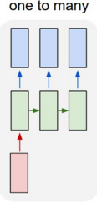
RNN-LM
What’s RNN
operate over sequences of vectors
Feature:
Fixed-size input
Fixed-size output
Task:
FNN-LM
Image classification
Feature:
sequence output
Task:
Image captioning
Note:
rectangle = a vector arrow = function( e.g. matrix multiple)
Red for input vector green for RNN’s state blue for output vector

Slide 21
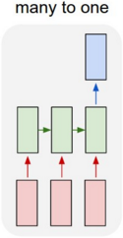
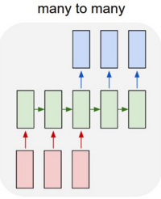
RNN-LM
What’s RNN
operate over sequences of vectors
Feature:
sequence input
Task:
sentiment analysis
Feature:
sequence input
sequence output
Task:
Machine Translation
Any questions ?
Note:
rectangle = a vector arrow = function( e.g. matrix multiple)
Red for input vector green for RNN’s state blue for output vector

Slide 22
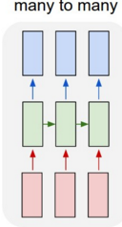
RNN-LM
What’s RNN
operate over sequences of vectors
Feature:
Synced sequence input and output
Task:
video classification (label each frame)
Note:
rectangle = a vector arrow = function( e.g. matrix multiple)
Red for input vector green for RNN’s state blue for output vector

Slide 23
RNN-LM
Vanishing gradient problem
Gradient is propagated back through the network either decays or grows exponentially
Long-Term Dependencies
More details ?

Slide 24
LSTM-LM
Reference
LSTM Neural Networks for Language Modeling (Martin Sundermeyer et. al, Interspeech 2012)
Motivation
learning long-term dependencies better
What’s LSTM
a very special kind of recurrent neural network which works, for many tasks, much much better than the standard version.
Details
A very good introduction: http://colah.github.io/posts/2015-08-Understanding-LSTMs/

Slide 25
Conclusion
Statistical N-Gram LM has two deficiency: no word similarity, limited context
FNN is a MLP in fact, FNN-LM use distributed representation for words to solve word similarity
RNN-LM can use any length context conceptually, suitable for LM task, but exists vanishing gradient problem and can’t learn long-term dependency well
LSTM is a special case of RNN designed for learning long-term dependency.

